Slide 1
Innovative Room Environment Monitoring System (IREM)
An Edge Computing in the IoT project by
Fabian Gobet
Tobias Erbacher
Vijaya Bhargavi
Jonas Fischer

Slide 2


Slide 3
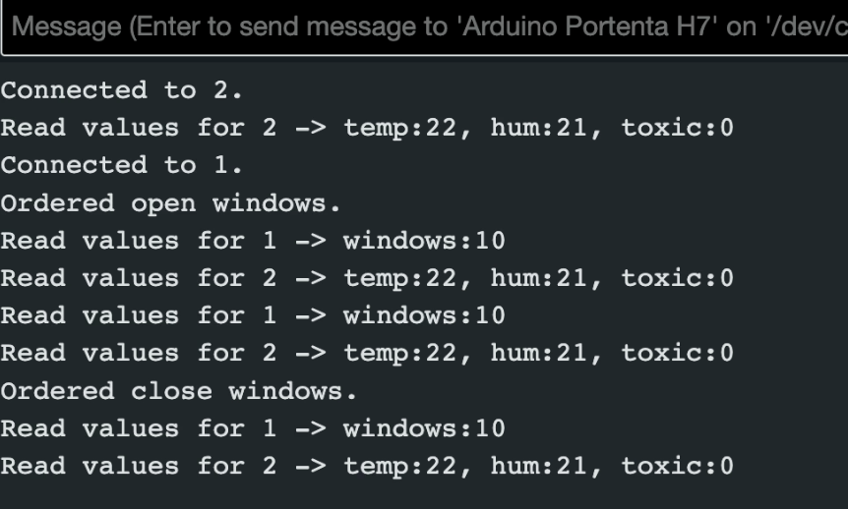
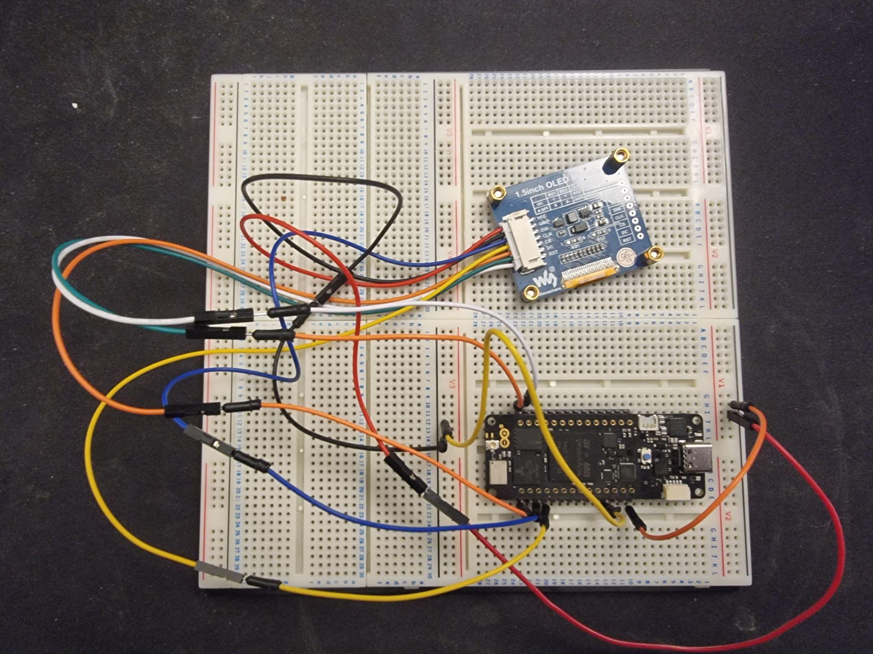
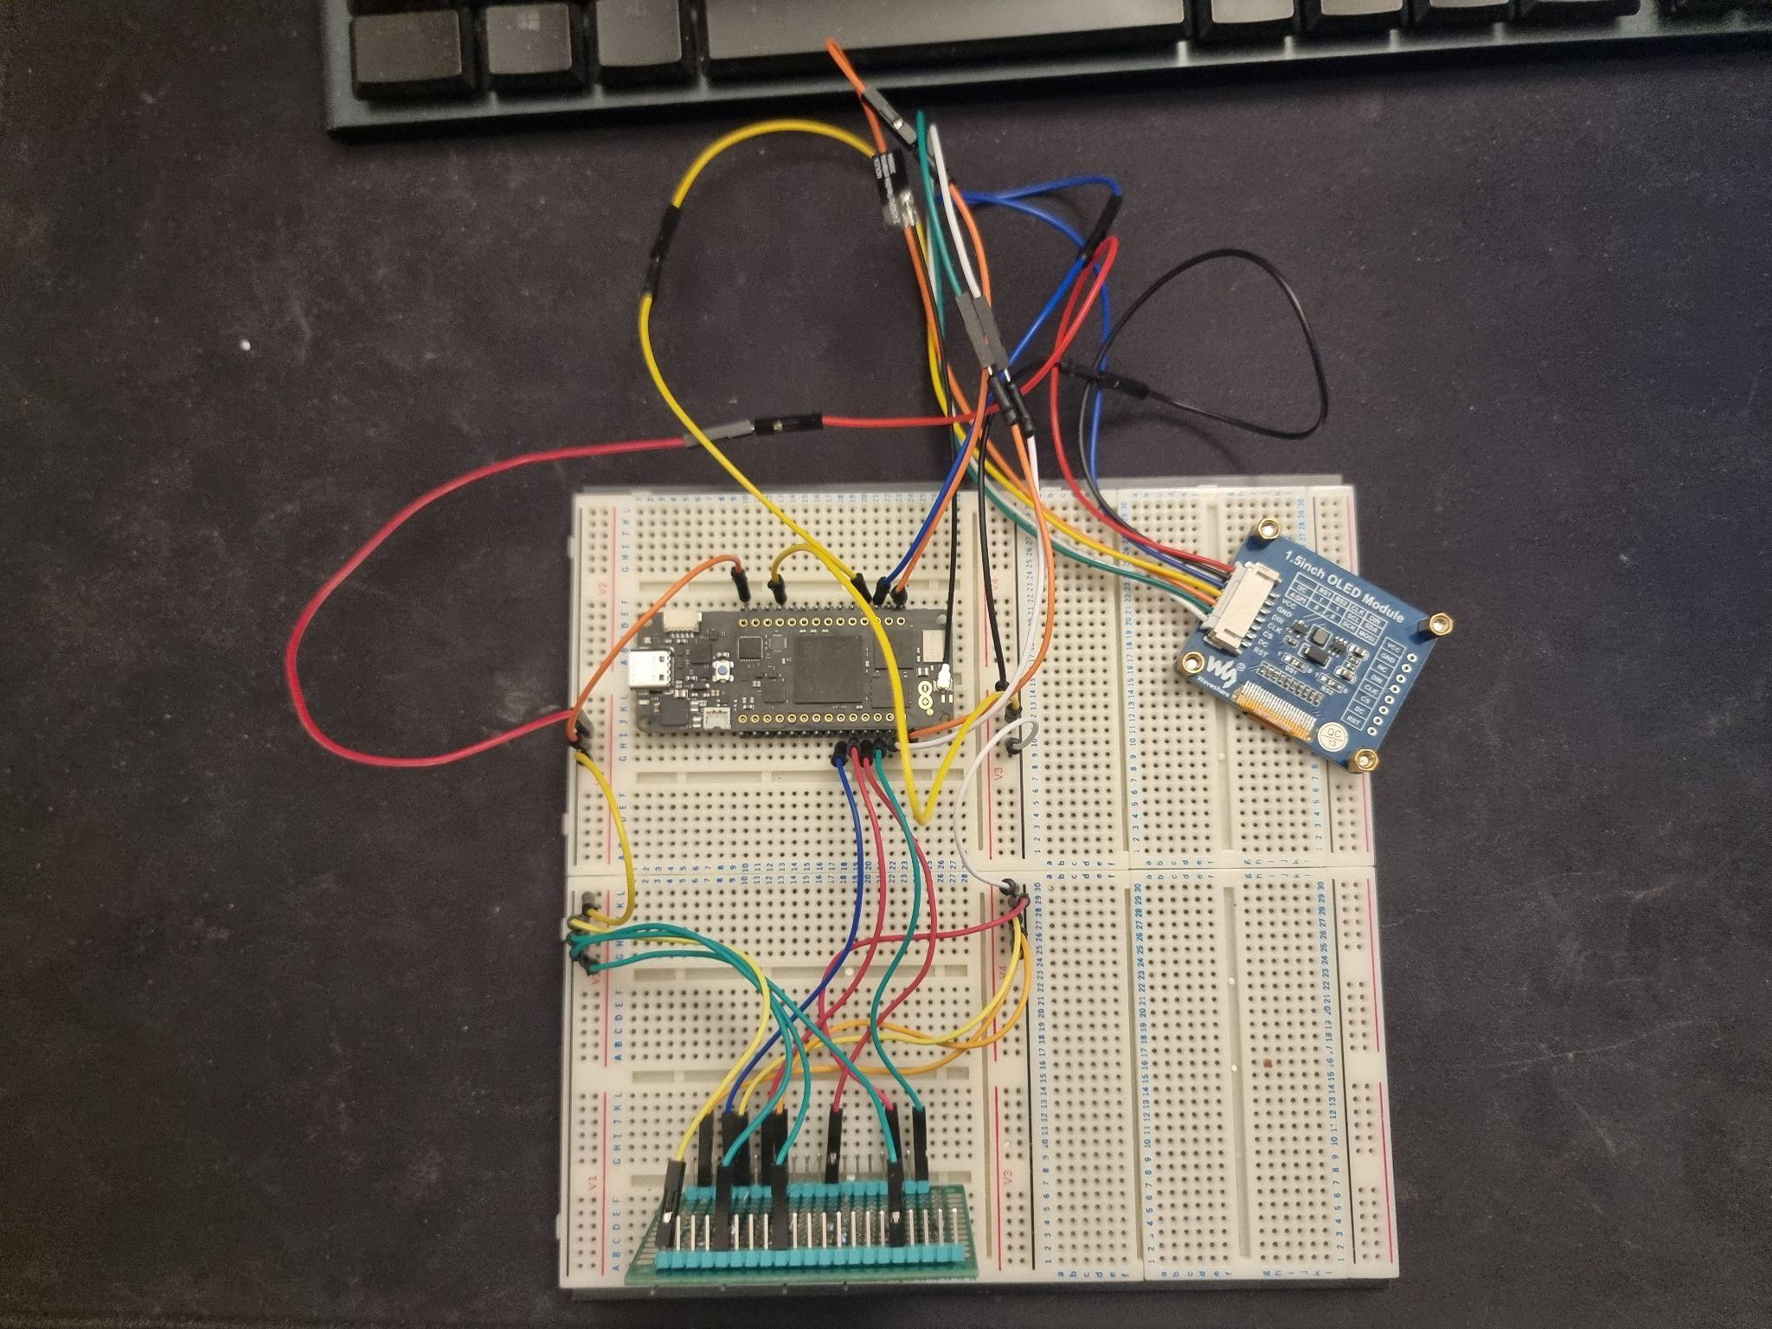
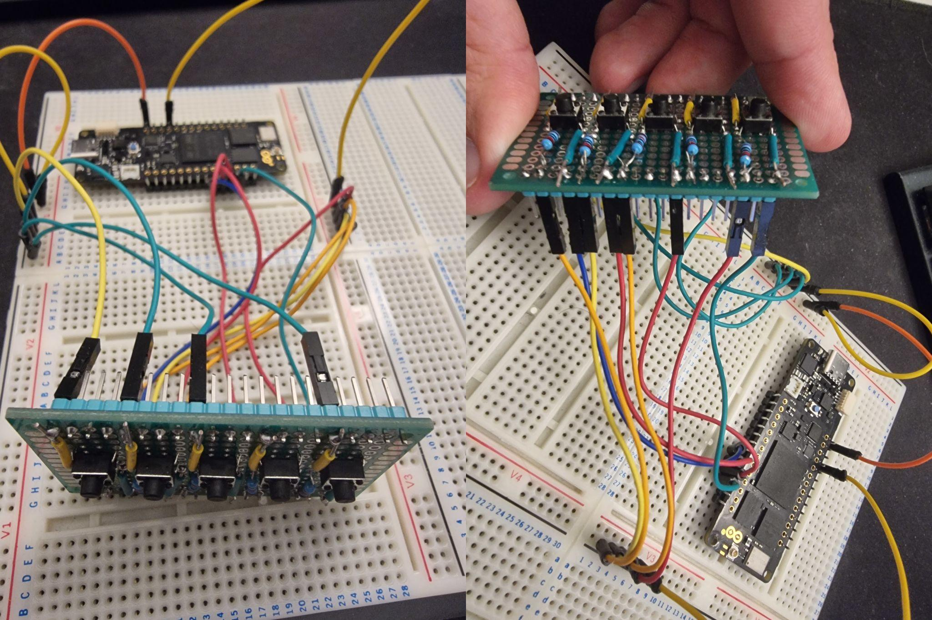
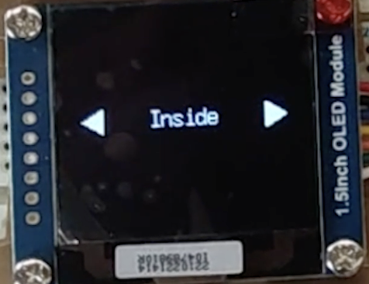
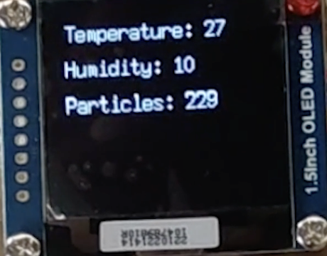
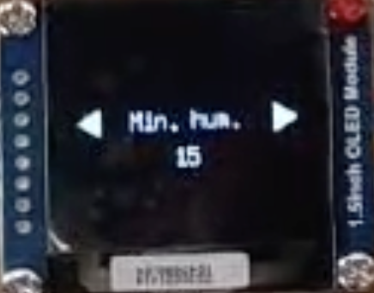
Central Unit
Notes:
The central unit is is the module of this project that connects to all the peripheral devices via BLE and continuously gets data from the sensors, sends directives to actuators, whilst being able to interact with the user via an LCD interface.
The hardware essentially comprises 4 buttons connected with a pulldown system, which will then act with an attached interrupt, and an LCD screen connected via hardware SPI.
To enable a fully functional and customized user interface we used the a known library U8G2 to draw things on the LCD, in conjunction with an abstract class that implements functionalities to switch between different screen tiles upon the user interaction and 3 different classes, Leaf, Leaf2 and InfoTile that present information and set information.
Because this module needs to both be responsive to user interaction and handle all the data gathering, processing and sending directives, it is important that all operations are non blocking. Therefore, to ensure mitigation of possible delays from routines, all routines and the main core loop of the system is designed in a fashion such that each process is independent from one another.
In other words, searching and ensuring connection from one device to another are independent processes, so it is fetching data from the devices, drawing things on the screen or even sending out directives to actuators.

Slide 4
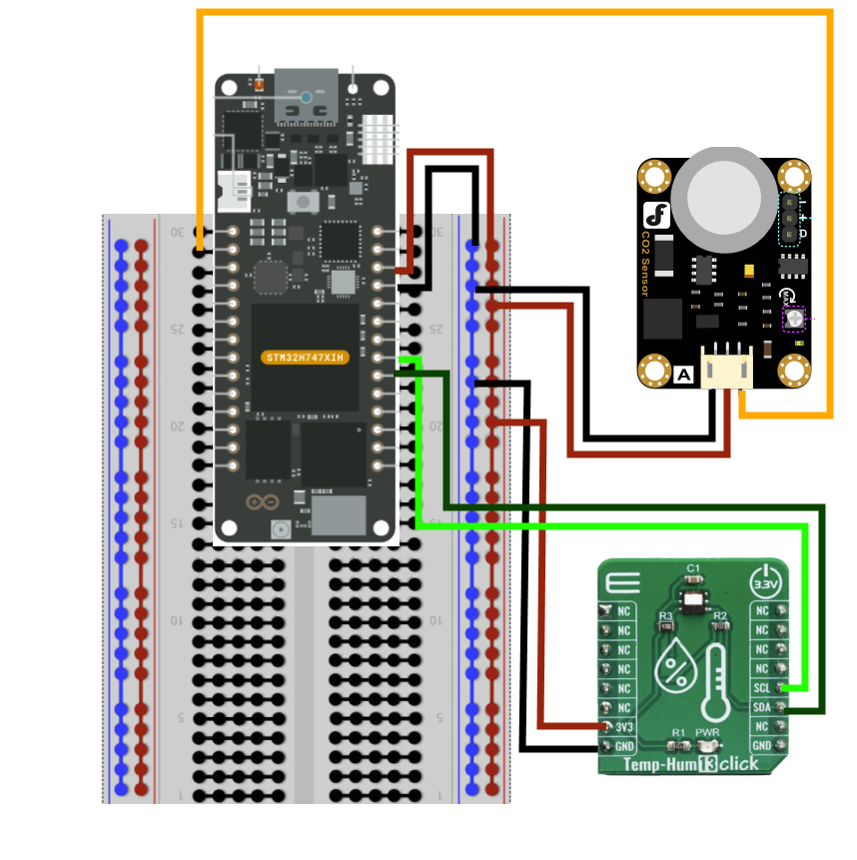
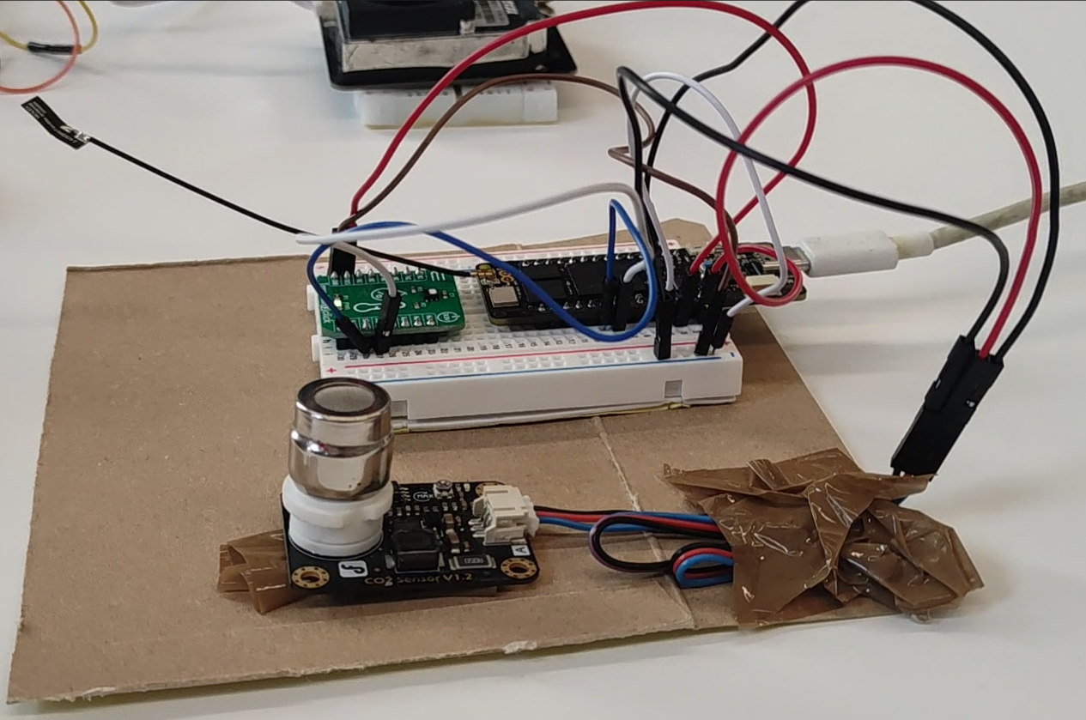
Indoor Unit
Objectives:
Continuously monitoring temperature, humidity,
and CO2
Connects to central unit via BLE
Sends values cast as integer to main

Slide 5
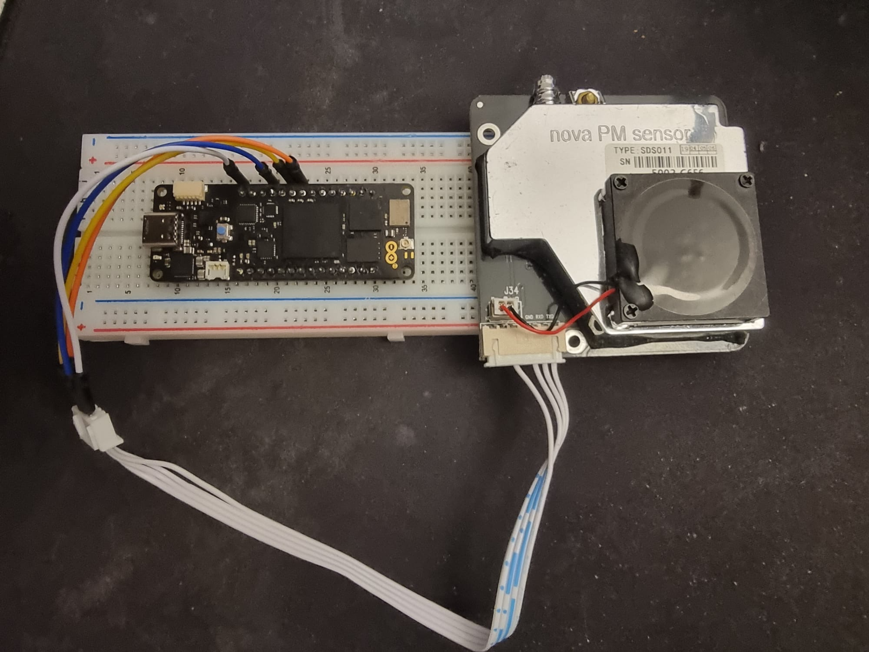
Outdoor Unit
Objectives:
To sense the dust particle density around.
The integer data fetched is mapped to a range.
This data is sent across the bluetooth to the central unit.

Slide 6
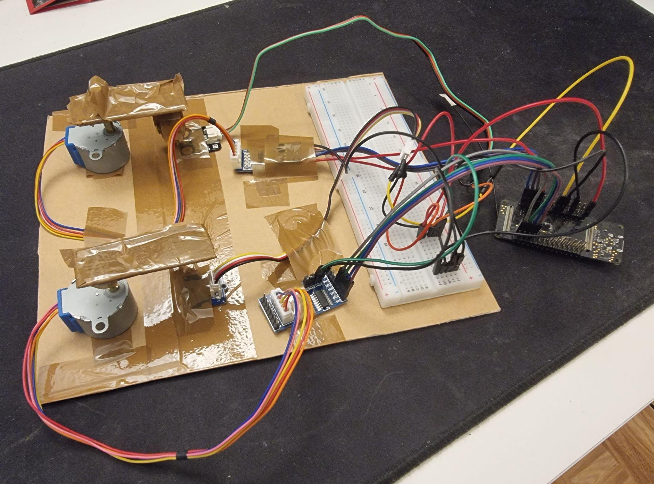
Window Unit
Objectives:
Continuously monitor windows’ opened/closed state.
Listen for instructions from central via Bluetooth.
Upon instruction received, compare window states.
Determine actions and execute.

Slide 7
Thanks for your Attention!
We open the stage for discussion.

Slide 8





Concept
Notes:
smart home monitoring system
For our semester project we decided to build the prototype for a smart home air quality monitoring system
Air quality
Moving on to the core functionality, our system excels in monitoring air quality within individual rooms. We've integrated sensors that provide real-time data on crucial parameters like CO2 concentration, temperature, and humidity.
But our monitoring capabilities extend beyond the confines of our homes. We're also keeping a close eye on the outdoor air quality, recognizing that external factors play a significant role in maintaining a healthy indoor environment.
Window Control
One of the standout features of our system is its ability to take action based on the collected data. For instance, we've implemented an intelligent window control system. The system can autonomously open or close windows, responding dynamically to the air quality conditions detected
Main Control
The main control unit serves as the brains of our operation. It collects data from the distributed sensors, making informed decisions to optimize the indoor environment for the well-being and comfort of its occupants.
Sensor Connectivity
To achieve this, we've strategically placed sensors throughout the house. These sensors form a network, and they're all connected via Bluetooth to our main control unit.

Slide 9
Components
Window Control
Room Monitoring
MAIN UNIT
(Control)
Outdoor Monitoring

Slide 10
Concept
Smart home monitoring
Window control
Air quality check
Bluetooth
Distributed sensors

Slide 11
Obstacles

